Slide 1

WEB BASED JOB SEARCHING WEBSITE
SUDHIKSHA ARADHYULA (22106010)
NIHARIKA BANDEKAR (22106136)
AABHA BHIDE (22106093)
ADITI GADHAVE (22106079)
PROJECT GUIDE
PROF. MAHESH PAWASKAR

Slide 2

Contents
INTRODUCTION
LITERATURE SURVEY
LIMITATIONS
PROBLEM STATEMENT
SYSTEM DESIGN
TECHNOLOGIES AND METHODOLOGY
IMPLEMENTATION
CONCLUSION
REFERENCES

Slide 3
Introduction
Welcome to the world of job searching, where opportunities abound and careers take flight.
OBJECTIVES :
Our job searching portal is designed to connect talented new mothers with their dream positions and help companies find the perfect candidates to drive their success.
Our platform provides the tools and resources to support you every step of the way.
With a user-friendly interface and personalized job recommendations, our portal streamlines the search process, saving you time and effort.

Slide 4
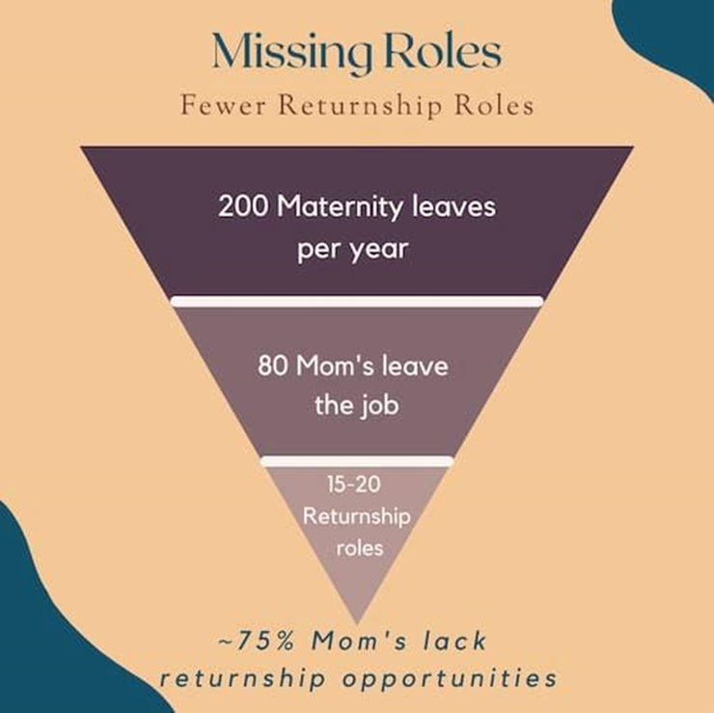
Literature Survey of the existing systems
Substantially unequal rates of returning to work are shown to exist and to have persisted over the last decade among women with occupations in different social classes.
Almost 48% of Indian women leave the workforce within four months of their return from maternity leave. That leaves 3 out of 4 returning mothers without an opportunity. Now consider the fact that almost 6,00,000 women go on maternity leave annually in India.
80.74% of variations in female employment are accounted by e-commerce and control variables
If a women is out of the workforce for just 3 years, she loses 37% of compensation power.

Slide 5
Limitations of the existing systems
Lack of Personalization
Data Privacy Concerns
Limited Skill Matching
Existing job searching portals often provide generic search results without considering the individual preferences and career goals of the users. This lack of personalization can result in users feeling overwhelmed by irrelevant job postings and may lead to lower user engagement.
Many existing systems have been scrutinized for their handling of user data, leading to concerns about privacy and security. Users may be hesitant to input their personal information and resume details into these portals due to the potential risk of data breaches or misuse of their sensitive information.
Job matching algorithms used by some portals have limitations in effectively matching the skills and qualifications of the users with the job requirements. This can result in users missing out on potential job opportunities that align with their expertise and experience.

Slide 6
Problem statement
Many women choose to take a career break during pregnancy and early motherhood. However, re-entering the workforce postpartum can be challenging due to potential discrimination, lack of flexible work options and sometimes family (social) pressure. This can lead to financial and personal hardship for mothers who want to continue their careers.
Solution Approach:
We are creating a job platform specifically for women seeking to return to work after taking maternity leave. The platform will connect women with employers offering flexible work hours, remote options, and family-friendly policies. We have partnered with organizations to provide access to flexible schedules. We also offer health benefits packages, including 2 free annual check-ups for women who get jobs through our platform. Additionally, we host seminars on topics like women's empowerment, transitioning back to work postpartum, and work-life balance for mothers. By providing a supportive community, relevant resources, and family-friendly job opportunities, we aim to help women successfully relaunch their careers after starting a family.

Slide 7

Technologies and Methodologies
Codebase
The development team can ensure the platform is robust, secure, and adaptable to future needs. By employing industry-standard languages for web development like
CSS
Javascript
HTML
XAMPP - mysql ( php )

Slide 8

Implementation
1
Development
The first step in the implementation process is the development phase. This includes the actual coding of the web-based job searching portal.
The development team works on creating the user interface, database integration, and other technical functionalities required for the portal.
2
Testing and Quality Assurance
Once the development phase is completed, the portal will undergo rigorous testing and quality assurance procedures.
This step ensures that the portal is bug-free, user-friendly, and performs seamlessly across different devices and browsers. It also includes checking for security vulnerabilities and data protection measures.
3
Deployment and User Training
After successful testing, the portal will be deployed to the production environment. This involves setting up the necessary servers, configuring the domain, and making the portal live for public access.
Furthermore, user training sessions will be conducted to familiarize job seekers and employers with the features and functionalities of the portal.

Slide 9
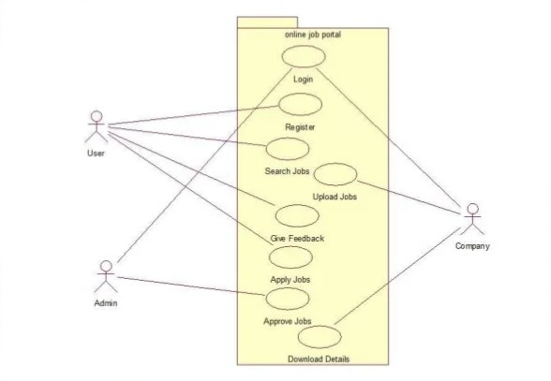
access.
System Design
Overview
The system design of the web-based job searching portal involves defining the architecture, components, and interactions that make up the platform.

Slide 10
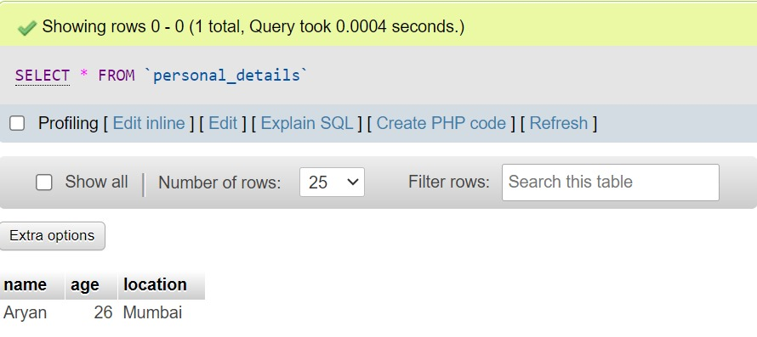
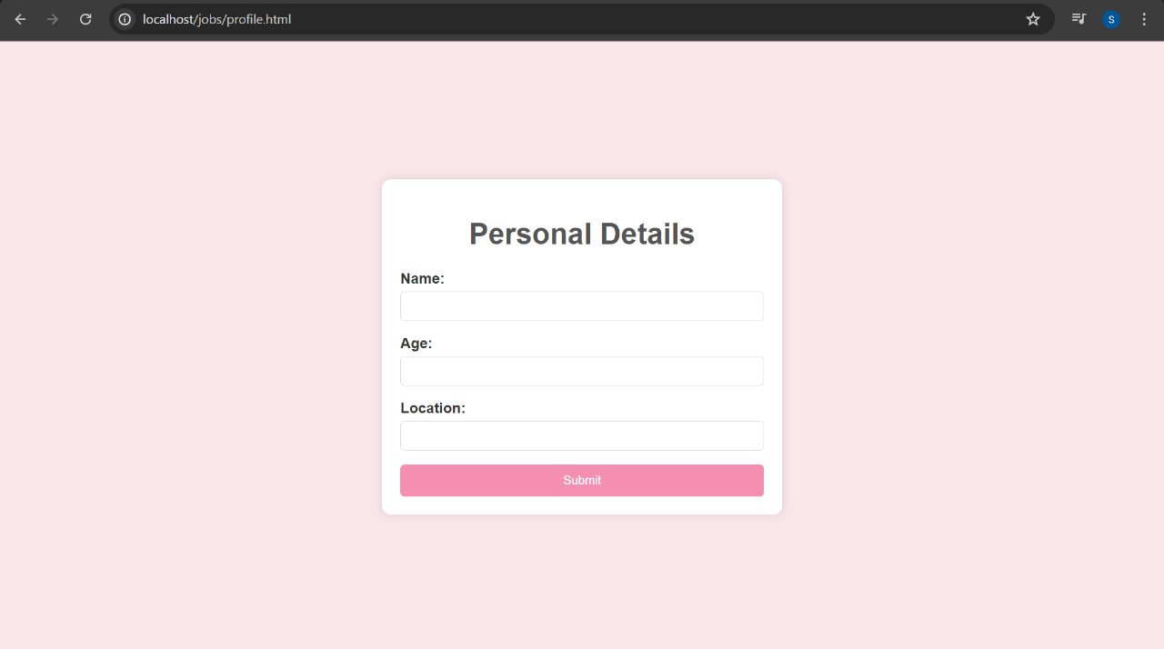
Database is connected to this page (details will be stored as per the number of entries)
DataBase

Slide 11
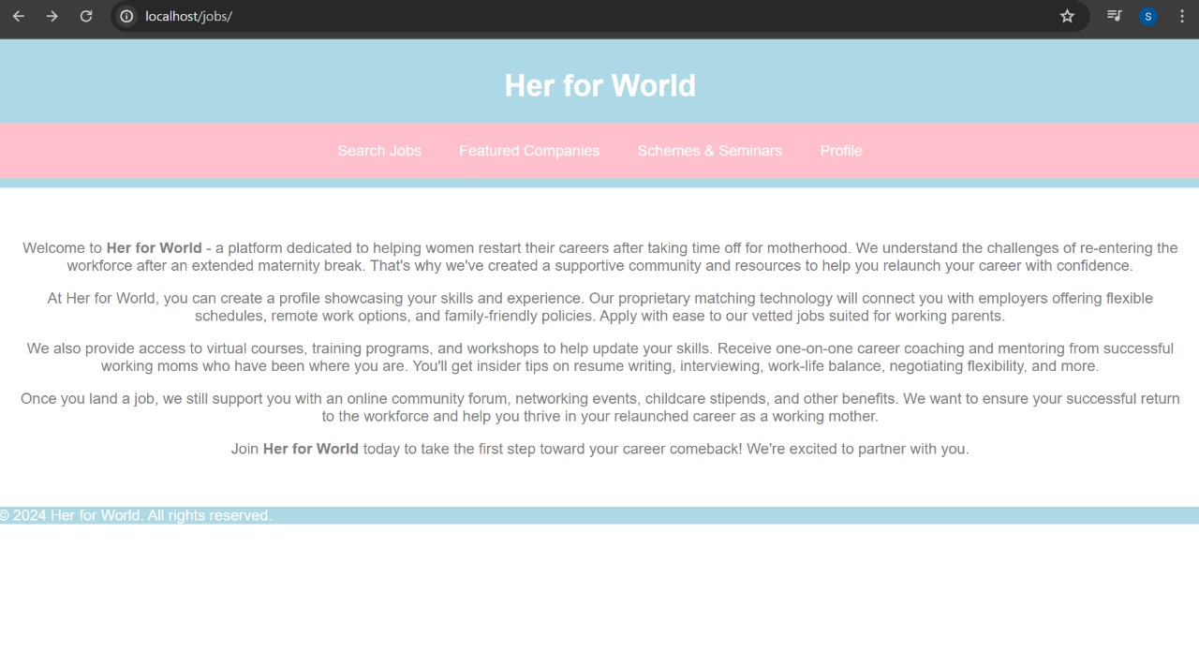
Front Page

Slide 12
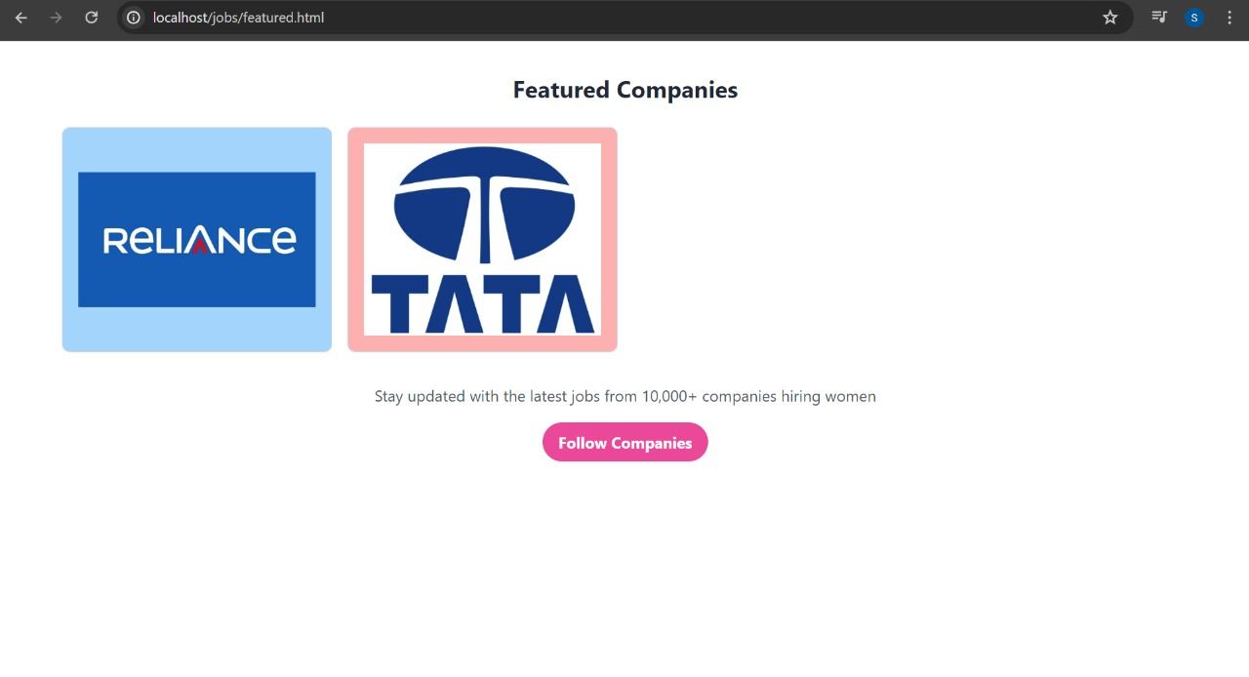
Featured company section

Slide 13
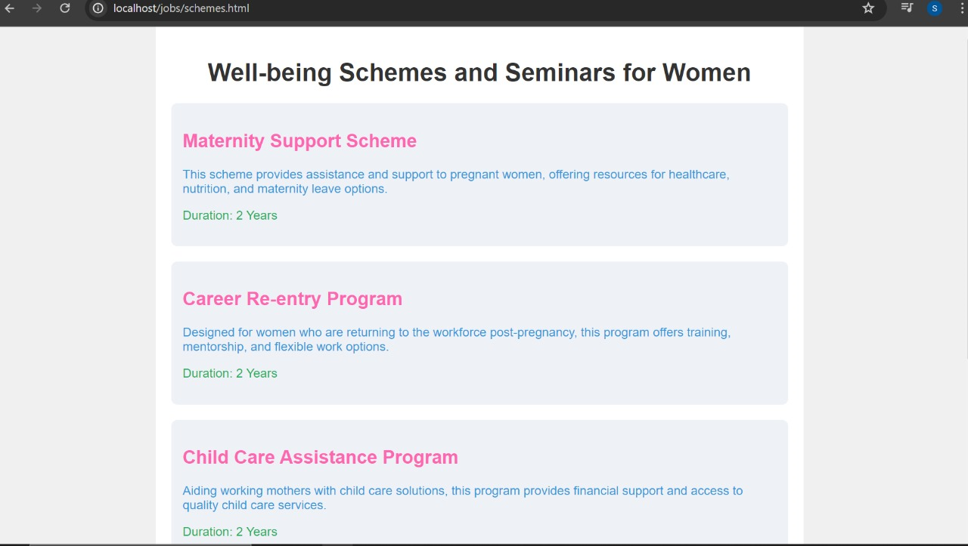
Scheme Page

Slide 14
Conclusion
We are creating a job platform specifically for women seeking to return to work after taking maternity leave. The platform will connect women with employers offering flexible work hours, remote options, and family-friendly policies.
We have partnered with organizations to provide access to flexible schedules. We also offer health benefits packages, including 2 free annual check-ups for women who get jobs through our platform.
Additionally, we host seminars on topics like women's empowerment, transitioning back to work postpartum, and work-life balance for mothers. By providing a supportive community, relevant resources, and family-friendly job opportunities, we aim to help women successfully relaunch their careers after starting a family.

Slide 15
References
1)Zhang, Xiaoqi, and Yanqiao Zheng. "Gender differences in self-view and desired salaries: A study on online recruitment website users in China." PLoS One 14, no. 1 (2019): e0210072.
2)Madera, Juan M. "Using social networking websites as a selection tool: The role of selection process fairness and job pursuit intentions." International Journal of Hospitality Management 31, no. 4 (2012): 1276-1282.
3) Quadlin, Natasha. "The mark of a woman’s record: Gender and academic performance in hiring." American Sociological Review 83, no. 2 (2018): 331-360
4)McRae, Susan. "Returning to work after childbirth: opportunities and inequalities." European sociological review 9, no. 2 (1993): 125-138.
5) Sovbetov, Yhlas. "Impact of digital economy on female employment: Evidence from Turkey." International Economic Journal 32, no. 2 (2018): 256-270.

Slide 16
THANK YOU

